Slide 1






SoK: What don’t we know? Understanding Security Vulnerabilities in SNARKs
Stefanos Chaliasos
Imperial College London, ZKSecurity
Jens Ernstberger - Technical University of Munich
David Theodore - Ethereum Foundation
David Wong - ZKSecurity
Mohammad Jahanara - Scroll Foundation
Benjamin Livshits - Imperial College London / Matter Labs

Slide 2
This talk
Motivation Why should we care about ZKP vulnerabilities?
Layers In which levels can something go wrong?
Impact What could be the impact of ZKP vulnerabilities?
Threat Model What is the threat model of systems using ZKPs?
Taxonomy A Taxonomy of ZKP vulnerabilities
Defenses What can we do to prevent exploits ZKP?

Slide 3
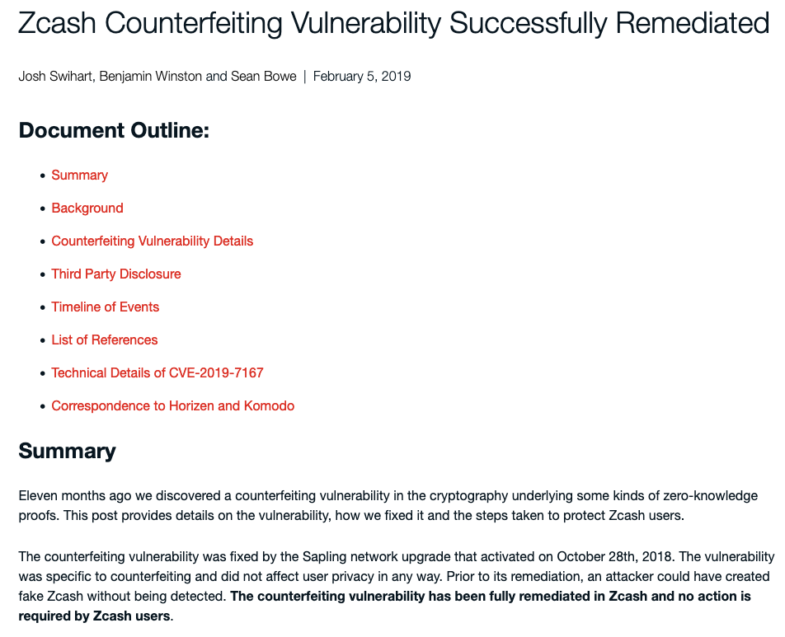
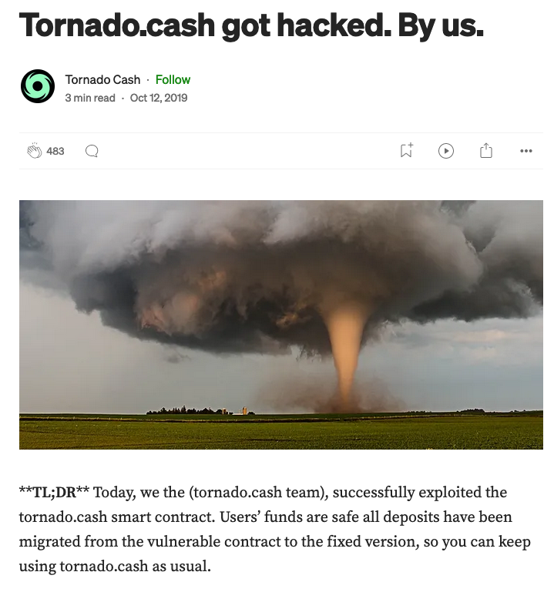
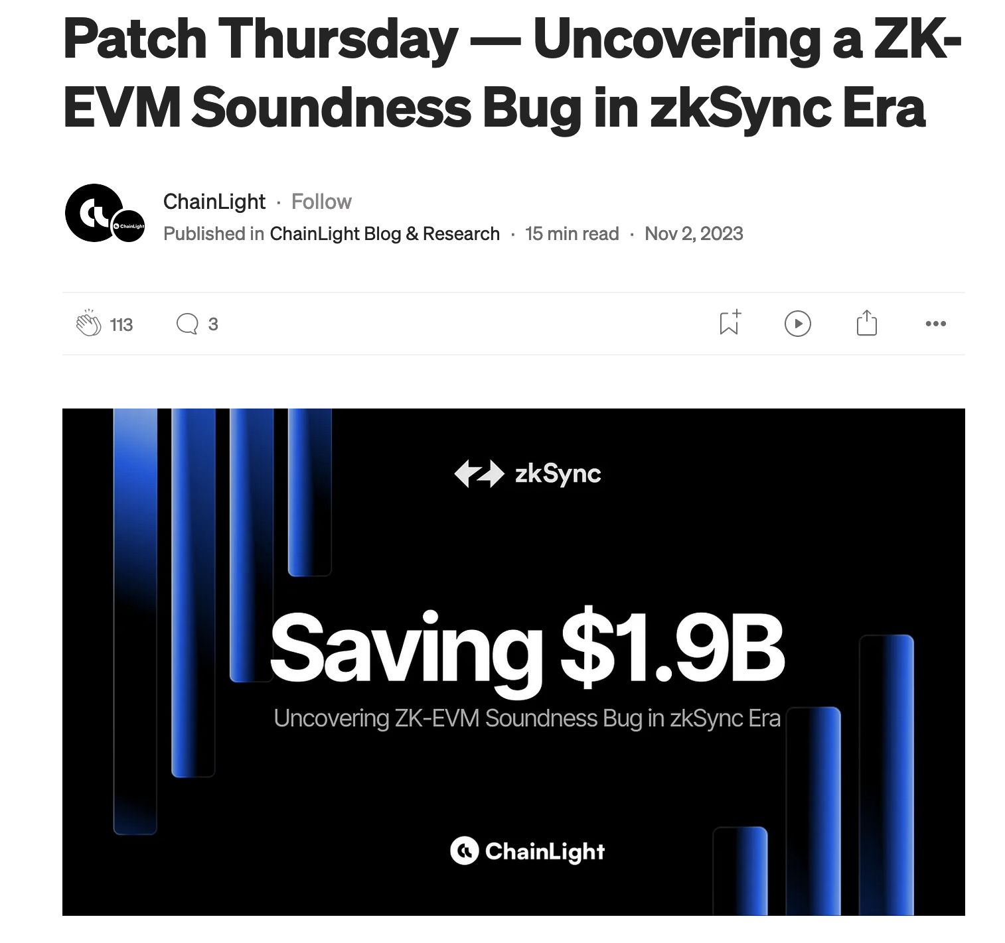
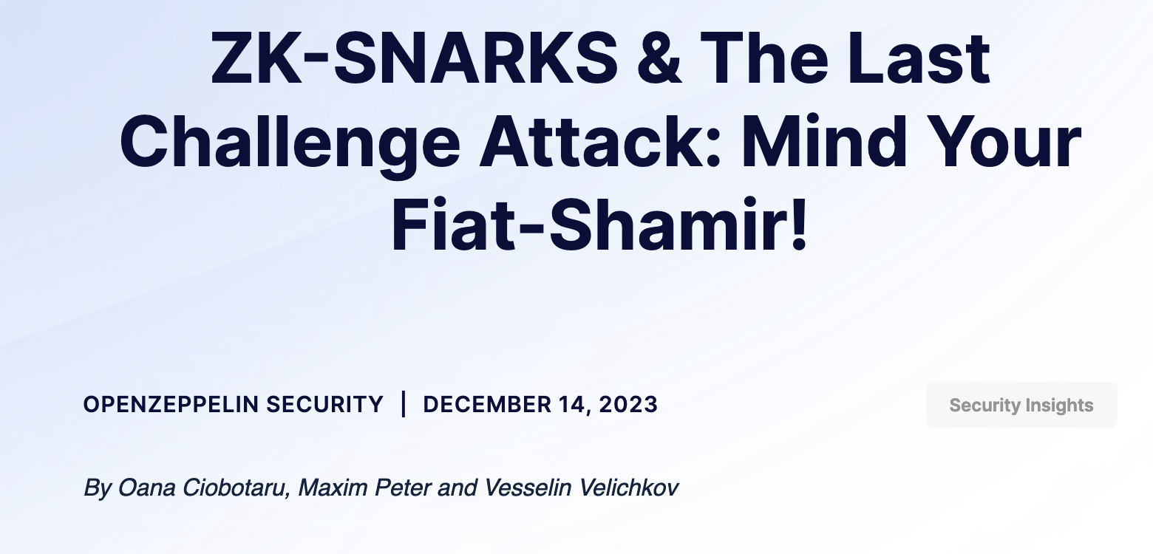
The state of ZKP applications
zk Rollups: > $5b
Zcash
zk apps
zkLogin
zkemail
zk-bridges
Private Programmable L1s/L2s
off-chain apps
https://l2beat.com/scaling/summary
https://defillama.com/

Slide 4
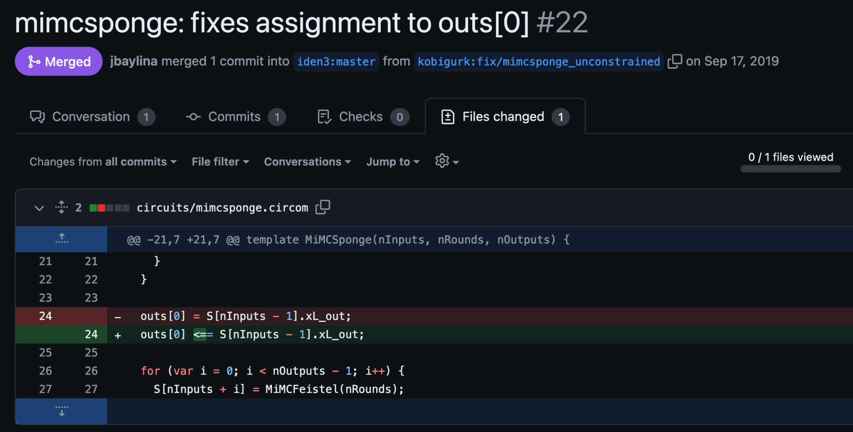
Example Circuit Vulnerability

Slide 5
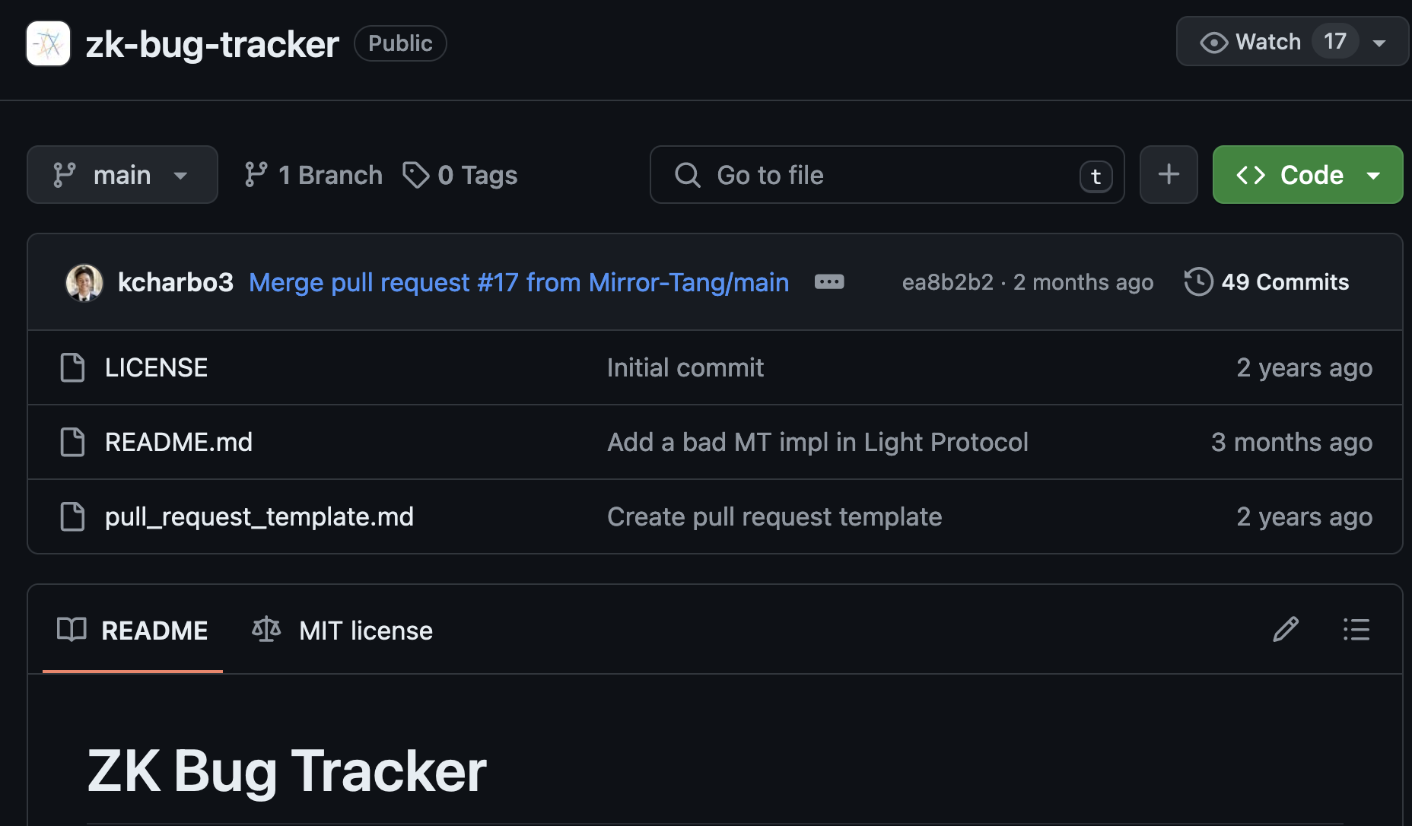
ZKP Security Taxonomy
zk-bug-tracker (0xParc – 2022)
https://github.com/0xPARC/zk-bug-tracker

Slide 6
Towards Understanding implementation vulnerabilities in ZKPs

Slide 7
SNARKs Layers (Workflow)
Real World
SNARK World
CIRCUIT
Implementation
Compiler
ℜ
Public Input
Witness
Generation
Intermediate
Representation
Private Input
INTEGRATION
FRONTEND
Application
x
x,w
BACKEND
crs
SNARK
Prover
pk
SNARK
Verifier
π
(Deterministic)
Setup
vk

Slide 8
SNARKs Layers (Workflow) – ZK-VMs
Real World
SNARK World
ZK-VM CIRCUIT
Implementation
Compiler
program
Public Input
Witness
Generation
Intermediate
Representation
Private Input
INTEGRATION
FRONTEND
Application
x
x,w
BACKEND
crs
SNARK
Prover
pk
SNARK
Verifier
π
(Deterministic)
Setup
vk

Slide 9
SNARKs Layers (Workflow) – Hierarchy
ZKP Application (e.g., Semaphore.sol)
Circuit implementation (e.g., semaphore.circom)
Frontend/Backend (e.g., circom/SnarkJS)
Field arithmetic, Elliptic curves (e.g., ffjavascript)
Proof System (e.g., Groth16)
Hardware, OS, Runtime (e.g., Linux / NodeJS)

Slide 10
Properties
Knowledge Soundness
A dishonest prover cannot convince the verifier of an invalid statement, except with negligible probability.
Perfect Completeness
An honest prover can always convince the verifier of the correctness of a valid statement
Zero Knowledge
The proof π reveals nothing about the witness w, beyond its existence

Slide 11



Threat Model – Adversaries
Network Adversary: observe the system and its public values
Adversarial User: submit inputs for proof generation to a non-malicious prover
Adversarial Prover: ability to produce and submit proofs
Verifier
Proof
User
Tx
L2 Sequencer/Prover

Slide 12
Threat Model – Vulnerability Impact
Breaking Soundness
A prover can convince a verifier of a false statement
Breaking Completeness
Cannot verify proofs for valid statements
Breaking Zero-Knowledge
Information leakage about the private witness

Slide 13
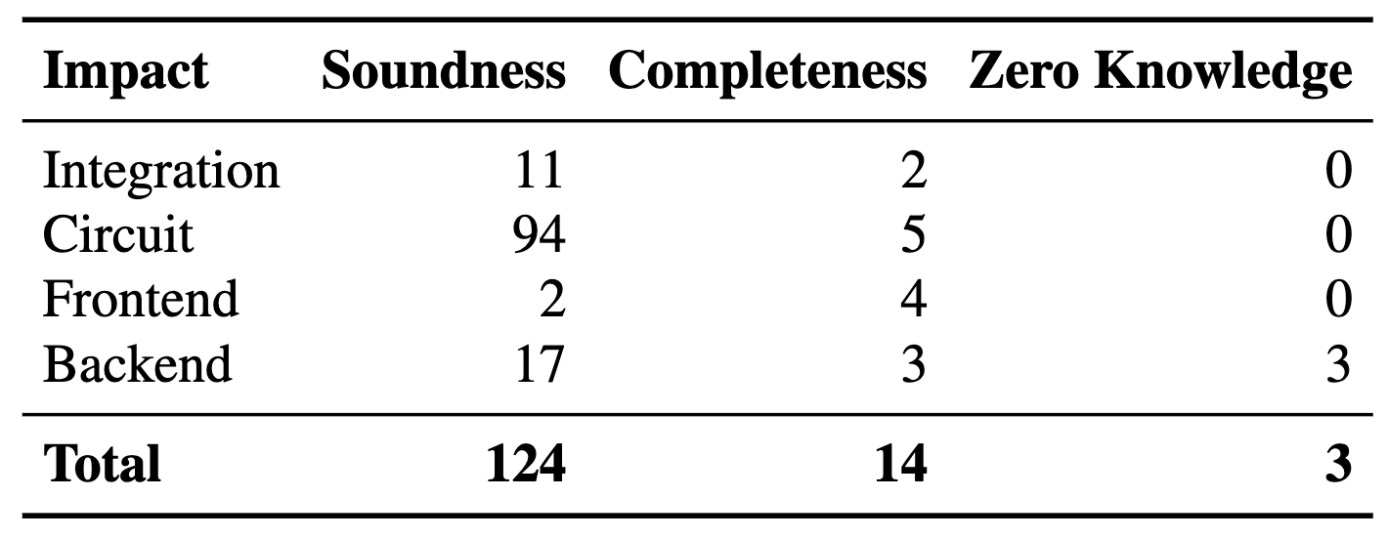
Analyzing and Classify ZKP Vulnerabilities
141 Bugs
Audit Reports
Vulnerability Disclosures
Bug Tracker
→ Not considering non-ZKP related vulnerabilities (e.g., reentrancy)

Slide 14
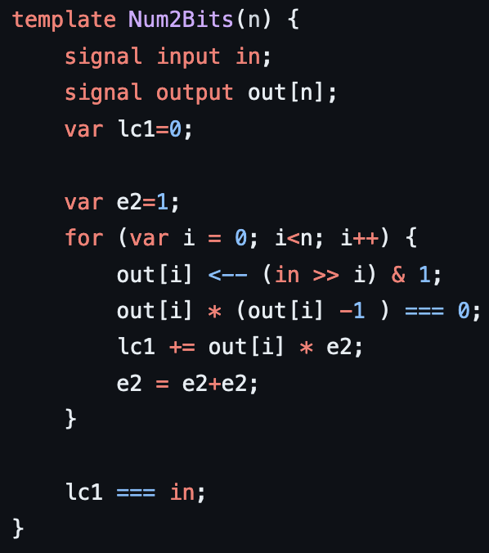
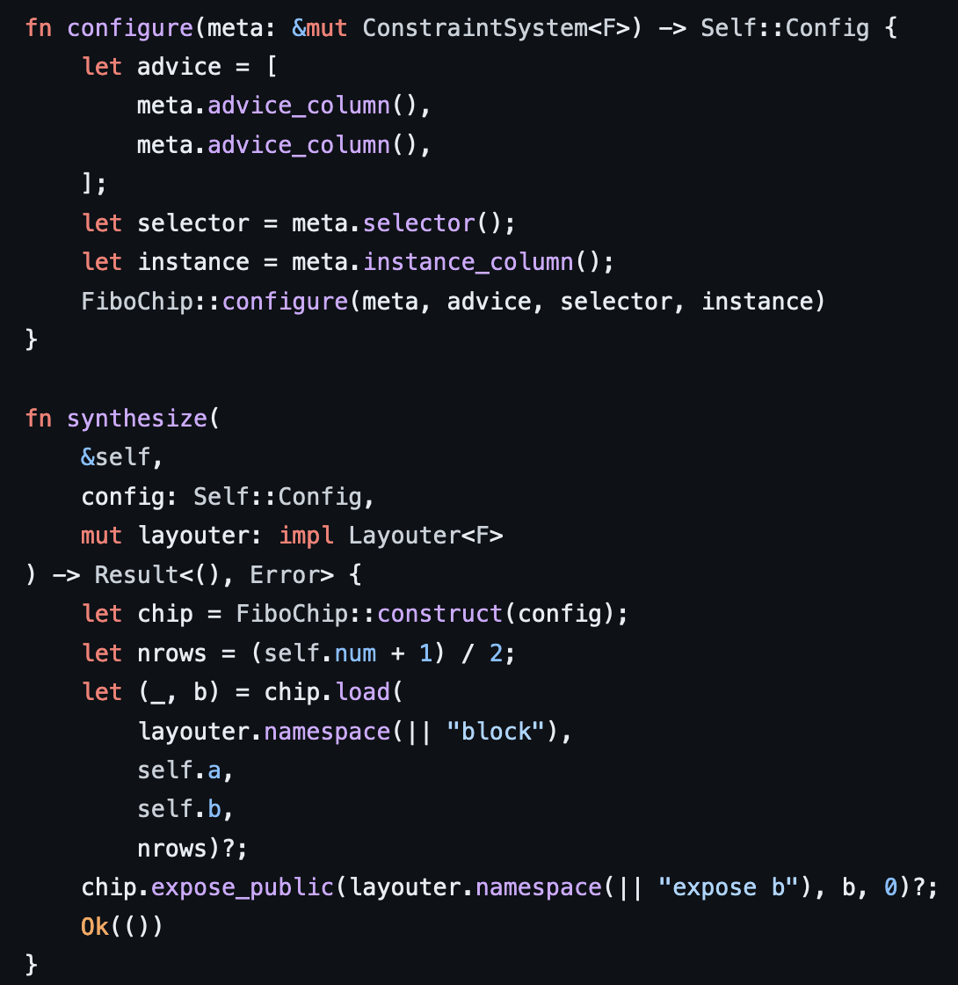
Circuit Layer
inp1, inp2, tmp3, tmp4, out5
tmp3 = inp1 + inp2
tmp4 = inp2 * 4
out5 = tmp3 * tmp4
inp1, inp2, tmp3, tmp4, out5
tmp3 == inp1 + inp2
tmp4 == inp2 * 4
out5 == tmp3 * tmp4
Computation
Constraints

Slide 15
Circuit Layer – Vulnerabilities
Underconstrained Vulnerabilities
Overconstrained Vulnerabilities
Computation/Hints Errors

Slide 16
Circuit Layer – Root Causes
Limited set of constraints -> Assigned but not Constrained
Common usage of selectors -> Incorrect Custom Gates
Field arithmetic -> Arithmetic Field Errors
Configurations / lack of semantics -> Unsafe Reuse of Circuit
Costs of constraints / Complexity ->
Missing Input Constraints
Wrong translation of logic into constraints
Out-of-circuit Computation Not Being Constrained
Specification issues -> Bad Circuit/Protocol Design
Usual mistakes -> Other Programming Errors (e.g., API misuse, incorrect indexing in arrays)
Different programming model
Optimizations /
Cryptography at the outer layer
Common Errors

Slide 17
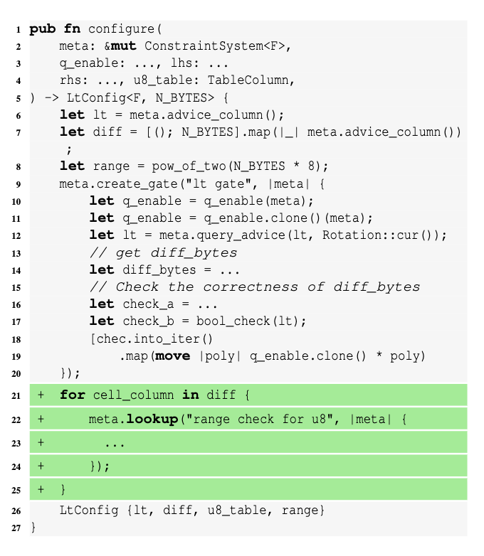
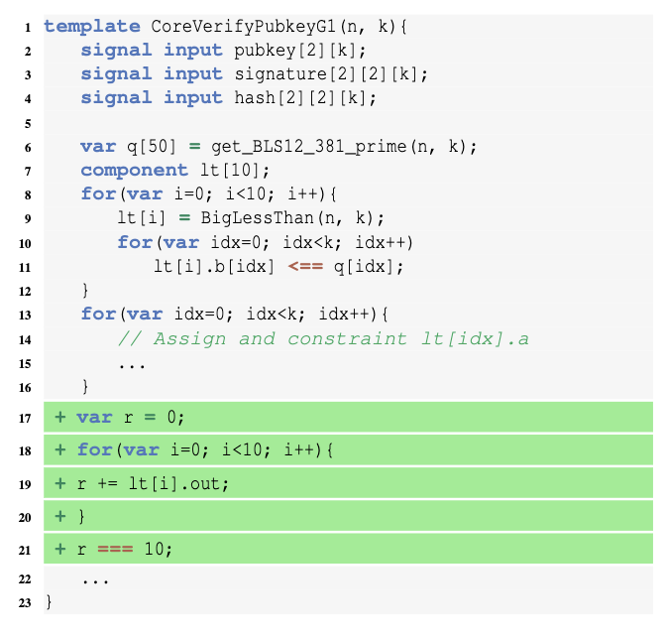
Circuit Layer – Example
Halo2 – Missing Input Constraint
Circom – Unsafe circuit reuse

Slide 18
Integration Layer
Passing Unchecked Data
Proof Delegation Error
Proof Composition Error
ZKP Complementary Logic Error

Slide 19
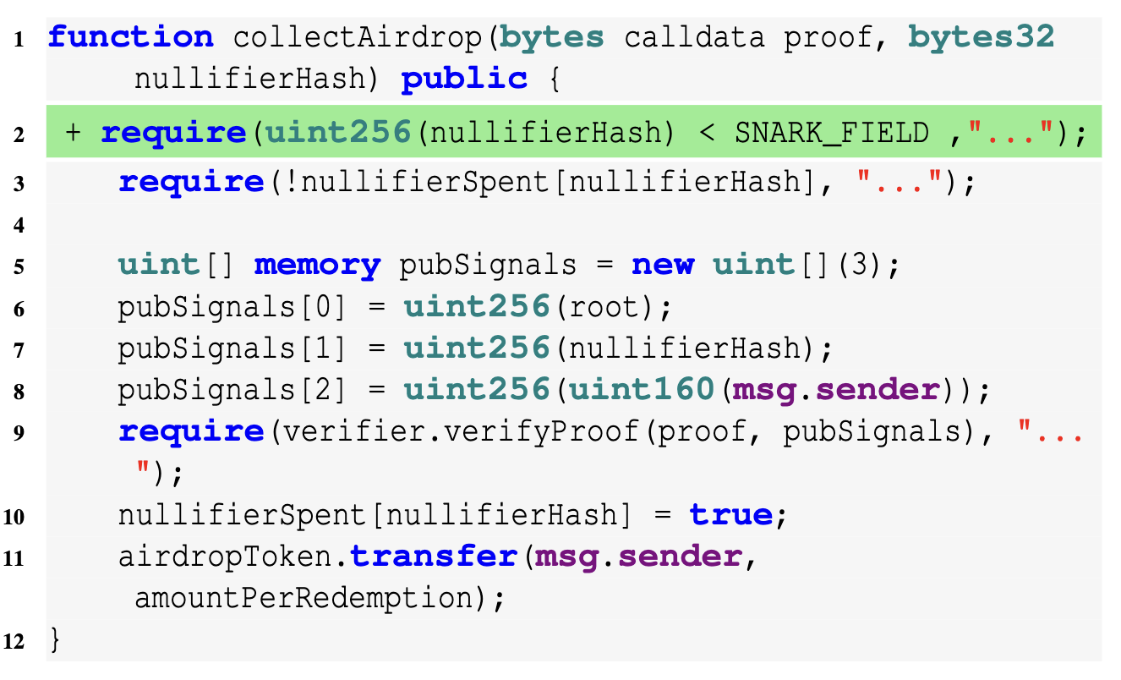
Integration Example (Missing Input Validation)

Slide 20
Frontend and Backend
Frontend
Incorrect Constraint Compilation
Witness Generation Error
Backend
Setup Error
Prover Error
Unsafe Verifier

Slide 21
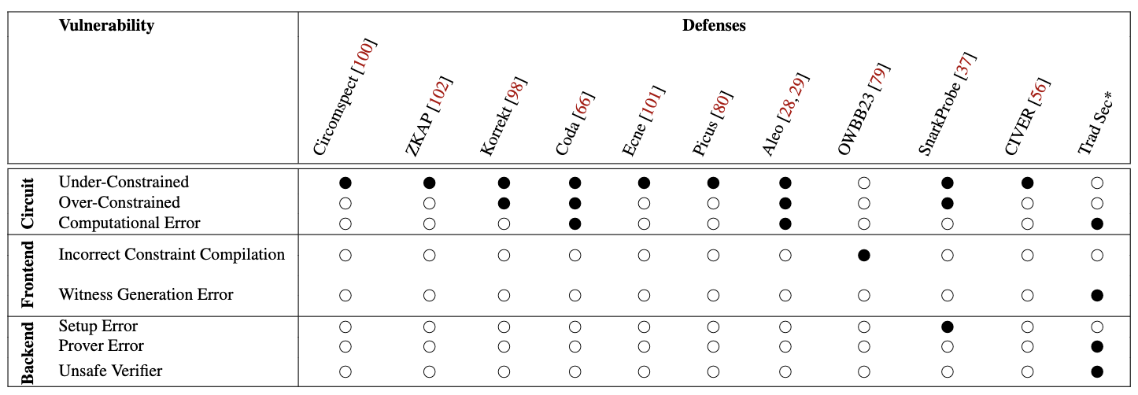
Security Tooling
Targeting specific DSLs / vulnerability classes
Scalability issues

Slide 22
Proof System Issues
Errors in the original proof system description
Incomplete descriptions
Examples
Counterfeiting – Setup Issue
Frozen Heart – Insecure Fiat Shamir Transformation
Soundness and Malleability in Nova IVC

Slide 23
Conclusions (1/2)
Why do we have bugs?
“not just maths”
Bugs in the implementations can break all the properties
“the poor user is given enough rope with which to hang himself”
Exposing cryptography to the outer layers
Missing of fundamental abstractions
Complexity / Different Threat Model
Lack of specifications

Slide 24
Conclusions (2/2)
What can we do?
More learning resources
Specifications
Easier and more secure programming languages
Better testing/security tooling (from testing frameworks to FV)

Slide 25
